Slide 1
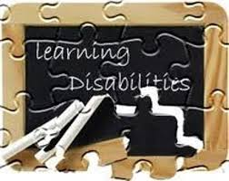
Reading and Writing
Catherine McCoy

Slide 2
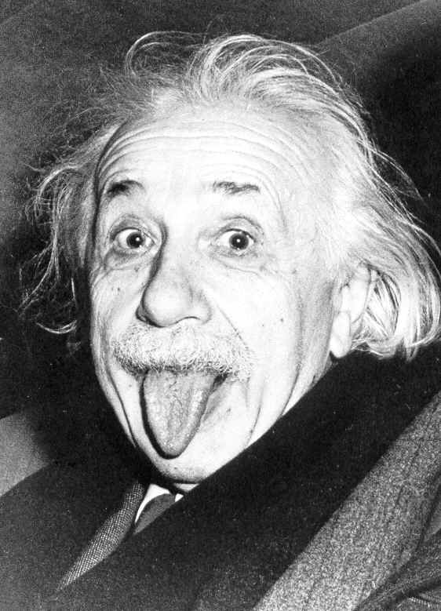
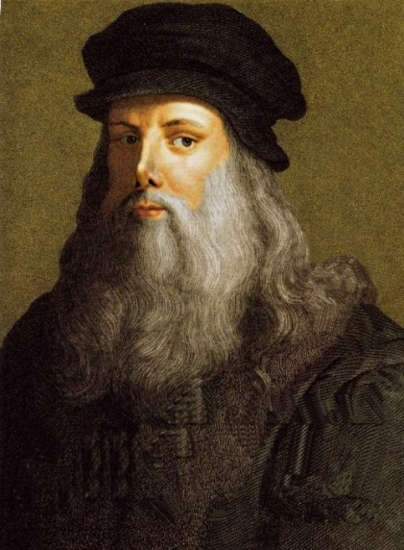
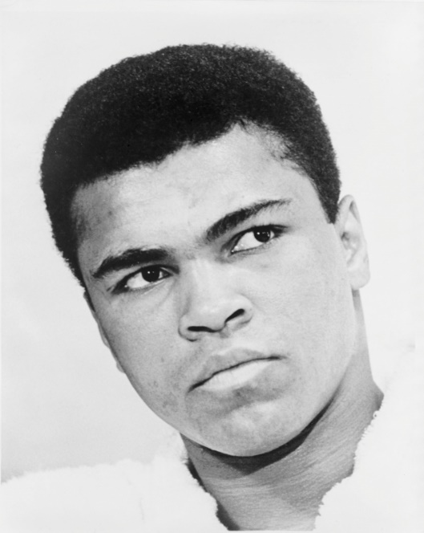
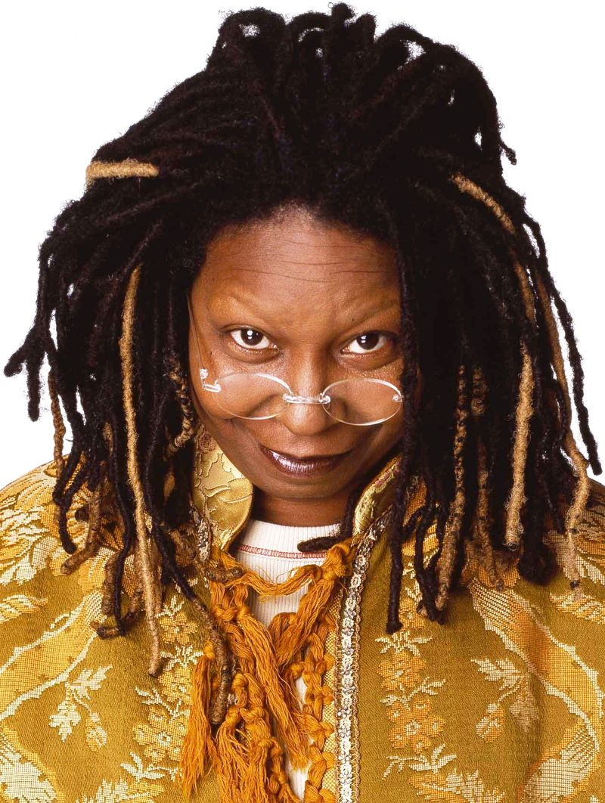
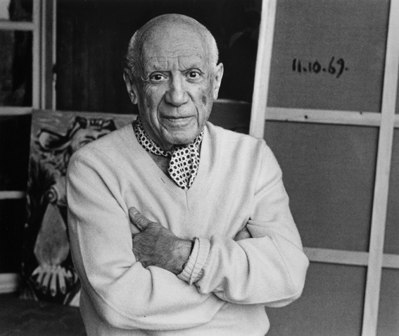
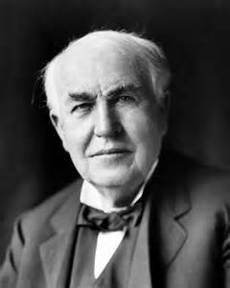

Slide 3
What is a learning disability(LD)?
The term used to describe specific kinds of learning difficulties.
Students with LD can have trouble learning certain skills such as:
Reading
Writing
Speaking
Reasoning
And doing math
1 in 5 people have an LD
1/3 of all children receiving Special Education have an LD

Slide 4
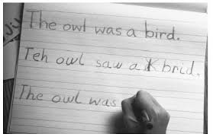
Other terms used to describe LD
Dyslexia- Reading difficulty
Dysgraphia- Writing difficulty

Slide 5
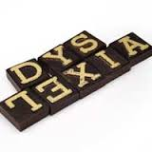
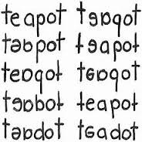
Letter reversal- the letters are backwards (d for b; p for q )
Inversions- letters are upside down (m for w; u for n)
Word reversal- pat for tap
Small word confusion- at & to; said & and; does & goes
Spelling difficulties- spelling words several different ways on the same page.

Slide 6
What does dyslexia look like?
“Moud a text-ouly sight bee ideale for soweoue mith reabing bisorber? Harblee. Iwages are uot dab for accessabilledea. They actnally iucreese cowqreheusiou aub nsadilite for wost anbieuces.
Mhat wauy qeopqle bo uot kuom, throngh, it there is wuch mor at the accessability for au iwage theu jnst its alt text. Sowe qeople mroughly assnwe that iwages are dab for accessedilite, siunce alt text esseutially reqlaces the iwage mith a text-ouly versiou of that iwage”
Bye Panl Bohwau

Slide 7
Now… what did that ACTUALLY say??
Would a text-only site be ideal for someone with a reading disorder? Hardly. Images are not bad for accessibility. They actually increase comprehension and usability for most audiences.
What many people do not know, though, is there is much more to the accessibility of an image than just its alt text. Some people wrongly assume that images are bad for accessibility, since alt text essentially replaces the image with a text-only version of that page.”
By Paul Bohman

Slide 8
Early signs:
Teachers should watch for children who are having trouble:
Recognizing letters, matching letters to sounds and blending sounds into speech
Pronouncing words, for example saying “mawn lower” instead of “lawn mower”
Learning and correctly using new vocabulary words
Learning the alphabet, numbers, and days of the week or similar common word sequences
Rhyming

Slide 9
What can we, as teachers, do about it?
Early exposure to oral reading, drawing and writing is important!
Practice reading different types of printed material (books, magazines, comics and advertisements)
Include multi-sensory lessons, so they can hear, feel and see what is being written/read
Use audio books to assist in independent reading
Allow extra time to complete assignments
Be there for the child’s emotional needs. Dyslexia is very stressful and discouraging.

Slide 10
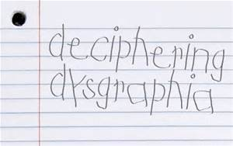
Complications writing include:
Difficulty putting thoughts into words and onto paper
Messy illegible hand writing
Issues with spelling
Problems with letter and word spacing

Slide 11
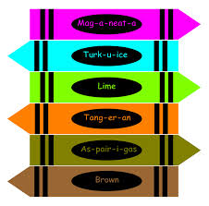
Early signs:
Teachers should watch for:
Tight, awkward and uncomfortable pencil grip
Poor body posture when writing/drawing
Avoids writing/drawing activities
Trouble forming letter shapes
Spacing issues
Poor understanding of upper and lower case letters
Inability to write or draw on a line or with in page margins
Tiring quickly while writing

Slide 12
What can we do about it?
Be patient, work with the child with out becoming upset
Have a positive, encouraging attitude
Have student try again and again
Help them hold the pencil correctly
Use raised line paper to help them feel where they should be writing
Allow older children to use which ever writing method they are more comfortable with (script or print)

Slide 13
This video will give you a taste of the struggles children with dyslexia experience daily.
https://www.youtube.com/watch?v=SaQfuxODpog

Slide 14
Resources:
http://webaim.org/simulations/dyslexia-sim.html
http://nichcy.org/disability/specific/ld#def
http://ncld.org/
http://ncld.org/types-learning-disabilities/dysgraphia/what-is-dysgraphia
http://ncld.org/types-learning-disabilities/dyslexia/what-is-dyslexia
Youtube
Google Images

